Slide 1
Goals (at least my goals)
Assemble genome
Find sex marker
Estimate effective population size

Slide 2
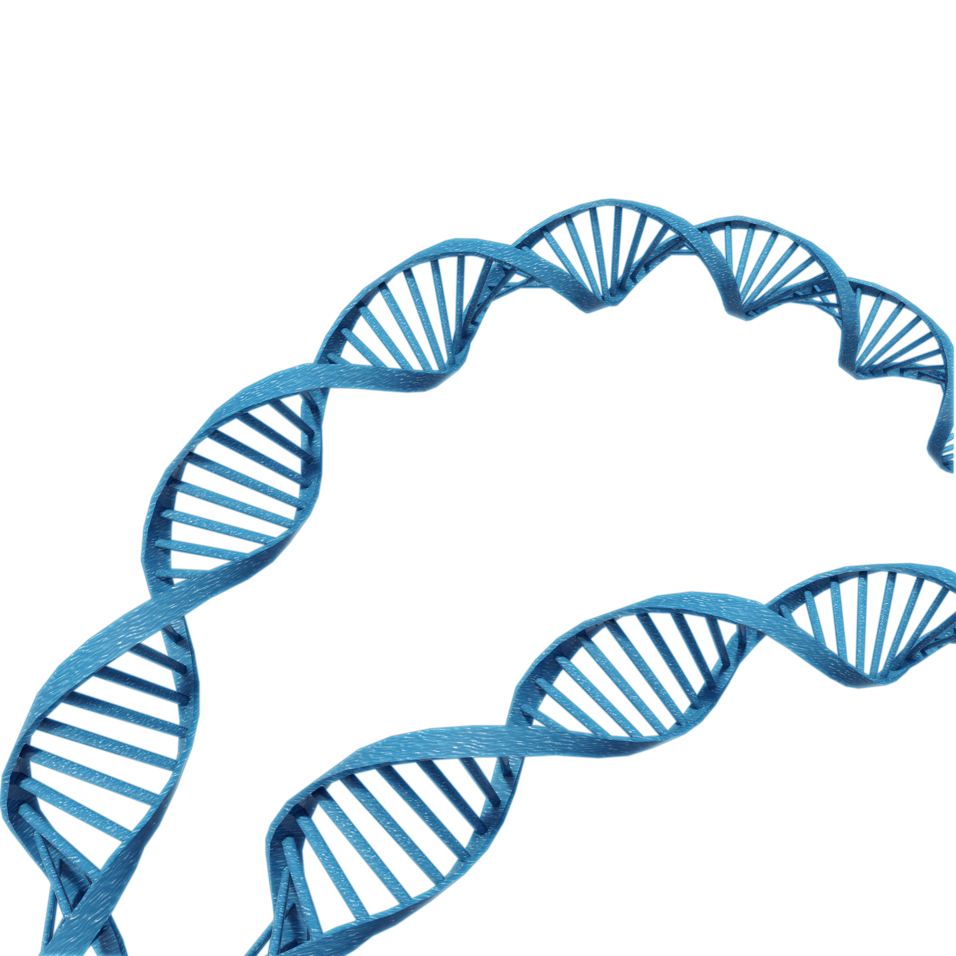
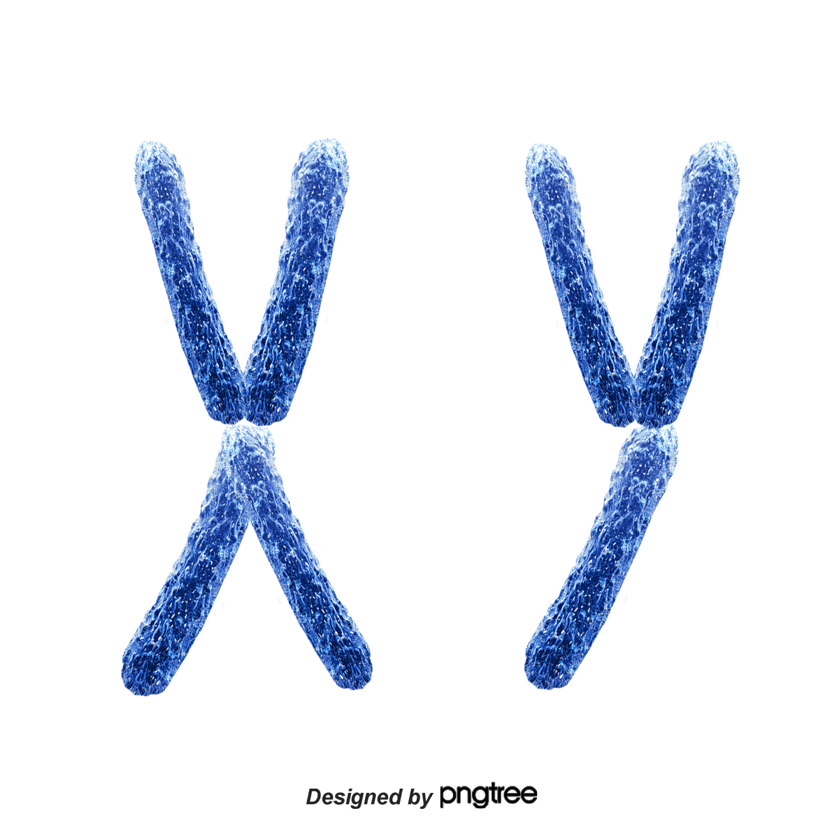
Genomes are very large
cell
nucleus
genome
A
T
T
C
G
T
C
G
A
C
C
G
G
T
A
A
C
G
A
A
Notes:
Human genome over 3 billion base pairs long

Slide 3
Can capture all of the genome by using multiple types of sequencing technologies
Use more current sequencing technology to create a high-quality genome assembly
long reads
hi-c
A
T
T
C
G
T
C
G
A
C
C
G
G
T
A
A
C
G
A
A
linked reads
Notes:
State chromosome level assembly means that our assembly is divided into chromosomes

Slide 4
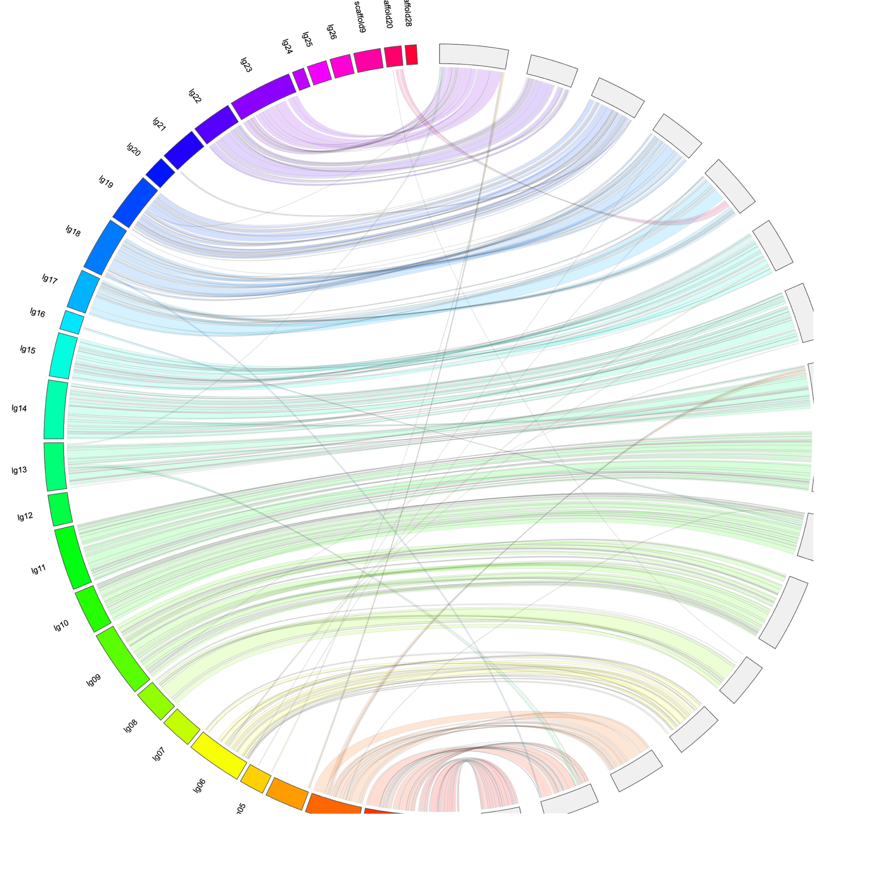
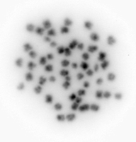
We achieved two high quality assemblies
One Male
One Female
Each sex assists in validating the other assembly
Number of chromosomes validated with karyotype
Notes:
Talk about the figure and how it shows diff in M and F
Explain what a karyotype is and how we got it, and how we got photograph, and what is in each of the blobs
Better explains the figures

Slide 5
How is the genome better than what we’ve been able to use?
Before had RAD assembly
RAD sequencing
Notes:
Compare RAD assembly to new
Explain why you have to have an assembly

Slide 6
Comparison metrics
Estimated genome size = 465 Mbp
 | RAD Assembly | New Assembly
Assembly Length | 12,905,745 bp | 437,273,953 bp
% of Estimated Genome | 2.58% | 94.4%
Average Length | 472 bp | 1,162,963 bp
Number | 27,297 | 376
New Assembly
DNA segment
Notes:
Put in human genome stats?

Slide 7
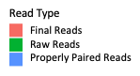
RAD assembly metrics
Birth Year | Average Alignment | Birth Year | Average Alignment
1993 | 35.3% | 2007 | 80.8%
1995 | 74.5% | 2008 | 80.8%
1996 | 69.6% | 2009 | 79.7%
1997 | 65.7% | 2010 | 78.0%
1998 | 70.7% | 2011 | 77.7%
1999 | 74.0% | 2012 | 77.7%
2000 | 70.3% | 2013 | 77.0%
2002 | 81.4% | 2014 | 77.6%
2004 | 81.2% | 2015 | 78.8%
2006 | 80.9% | 2016 | 78.7%
 |  | All Years Combine | 78.0%
Notes:
Explain figure
Something that may lead to technical issues is that we are not getting all of the information that we can from our data. We can only use markers that align in all individual and here you can see that alignments rates are fairly low
–– over 20% of reads didn’t align to our de novo RAD seq based assembly

Slide 8
Alignments improved with with the new assembly
 | RAD Assembly Alignments | New Assembly Alignments
All Years Combine | 78.0% | 92.6%

Slide 9
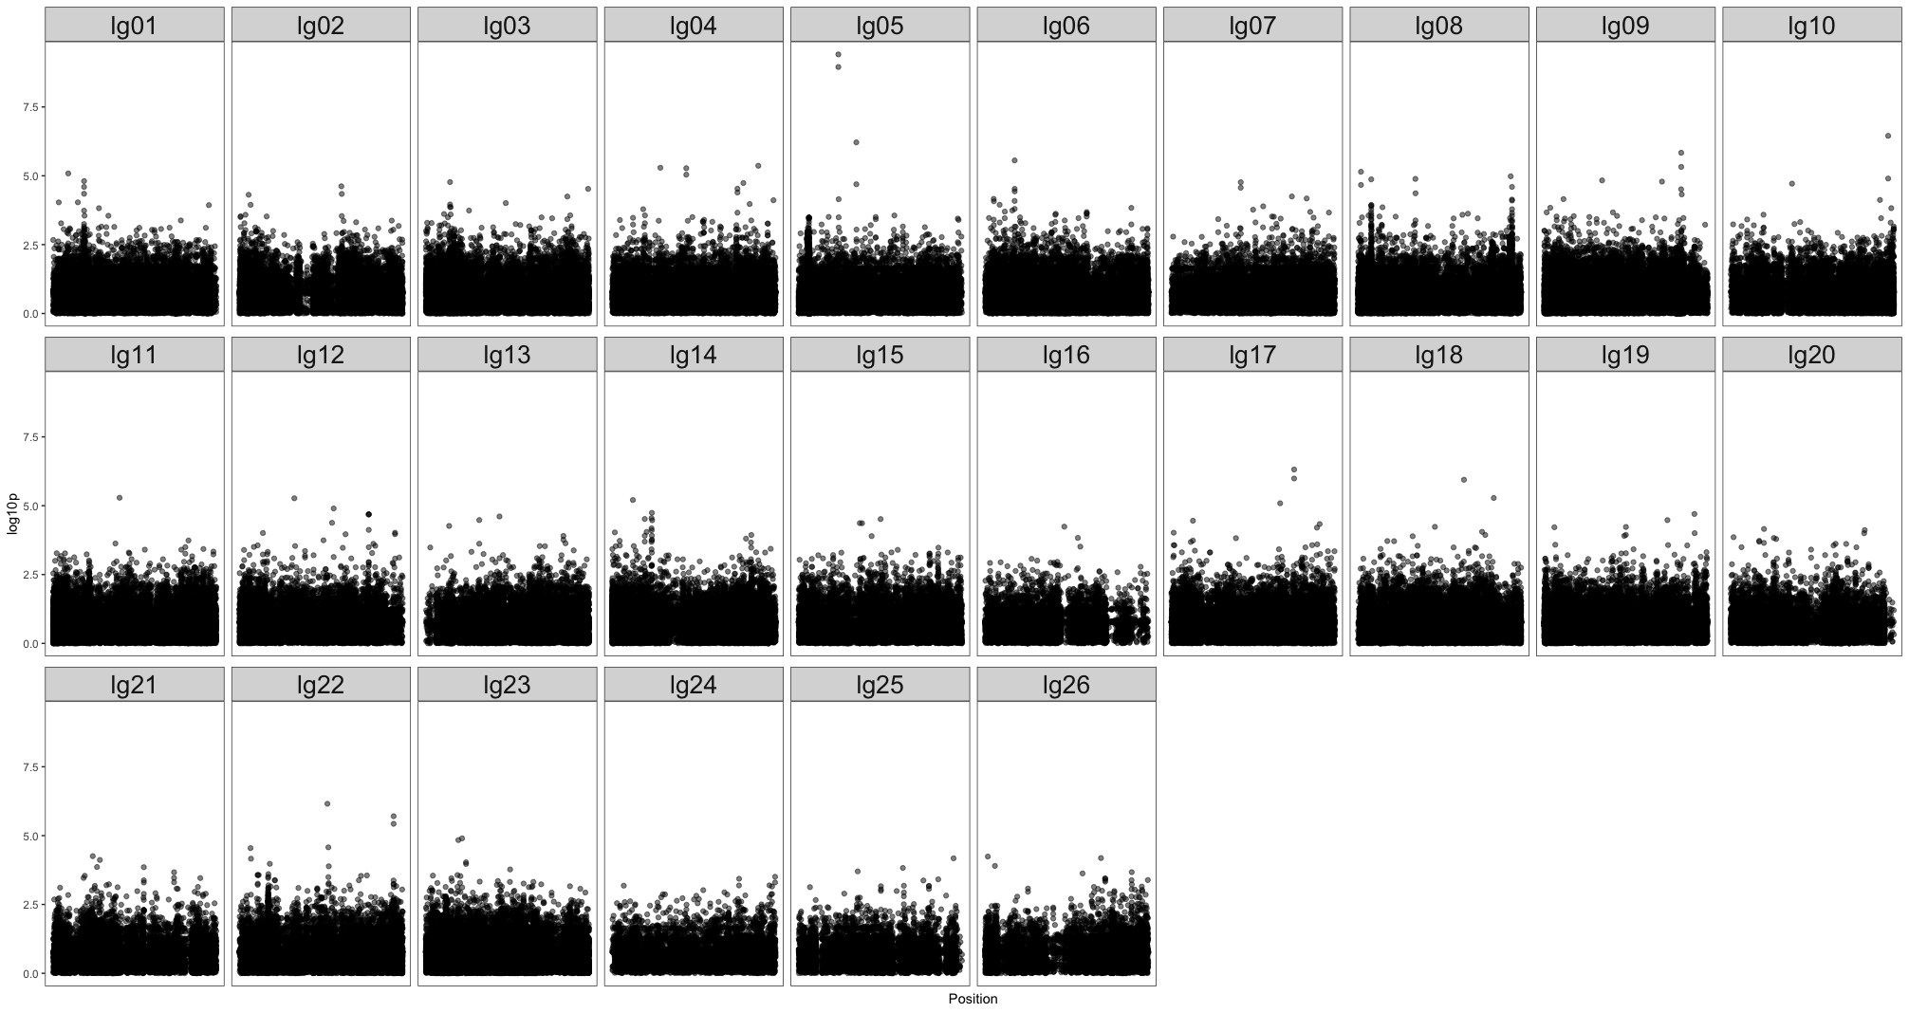
What we’ve already done with the genome
Sex Marker
Association Study
Notes:
State each block is a different chromosome
Unable to find sex marker with RAD data alone

Slide 10
Estimate the effective population size of wild delta smelt
Effective population size (N_{E}) determines how quickly populations are losing genetic diversity
50:500 rule
Can look at historical or contemporary N_{E}
Historical N_{E} is usually fairly stable
Contemporary N_{E} can give the effective population size of just a few generations back
Notes:
50:500 doesn’t apply to aquatic populations at well (generally used for terrestrial mammalian populations)
Definition: the number of individuals that an idealized population would need to have in order for a specified quantity of interest to be the same in the idealized population as in the real population
Genetic diversity is really important for populations to persist. New diversity comes from mutation so when you have a really small population you won’t see
Covid population is so huge so you get a bunch of mutation and the virus can adapt and respond to new environments
Larger population has greater genetic diversity, smaller populations have less genetic diversity
A common rule of thumb is the 50:500 rule––wild populations need to have a Ne of 500 to persist
Historical Ne is fairly stable unless there is a massive alteration to a population
Markers can’t be close together

Slide 11
Historical datasets
2208 wild fish from 1993 – 2016
RAD sequencing for each fish
Our initial estimates used the RAD Assembly
Notes:
First pass on effective population size just using RAD data
Simplify––we had a big dataset but without the reference genome analysis was suboptimal

Slide 12
Historical N_{E} using RAD assembly
Notes:
We didn’t have a genome assembly so Y-axis is very unreliable due to the noise from not having an assembly

Slide 13
Contemporary N_{E} using RAD assembly
Notes:
Walk through slides
Talk about numbers!
We might expect this if a population shrinks
In order to accurately estimate Ne we needto make sure that markers are on separate chromosomes and are not dependent on one another––they need to not me physically close to each other

Slide 14
Next steps
Improve genome
Re-estimate effective population size (1993-2016)
Analyze new data from 420 wild fish (2017 – 2018)
Further investigate sex marker
Finish PhD, get vaccinated and take a vacation
Notes:
2 fish where we sequenced the entire genome with complete resolution––interrogating 500 million positions in the genome very thoroughly
Had over 2500 samples where we sequenced with more sparse coverage––probably interrogating less than a million positions

Slide 15
Questions?

